Slide 1
DNA origami and Biocomputing, Bioimaging and AI for disease diagnosis
Biology for Engineers
21BE45
Prepared by, Dr. Akshatha Prasanna Assistant Professor Department of Biotechnology Dayanandasagar college of engineering

Slide 2
DNA origami
DNA origami is a nanoscale folding of long DNA molecule in to 3-D shape
at nanoscale
DNA origami technology, as a promising branch of DNA nanotechnology, is an effective technique for bottom-up fabrication of well-defined nanostructures ranging from tens of nanometres to sub-micrometres.
DNA origami involves the folding of DNA to create 2D and 3D objects at the nanoscale.
The concept of DNA origami relies on folding a long ssDNA called the scaffold
Bottom up self –assembly methods are considered to produce DNA origami nanostructure
Long single strand DNA molecules are folded by small designed molecules called staples.

Slide 3
How does DNA origami 3-D shapes are prepared
To produce a desired shape , first images are drawn with a method called raster- fill of a single long DNA strand molecule.( also called DNA template)
This design is then fed into a computer program that calculate the placement of individual staple strands. (Staple strands are small DNA molecule, which are specifically designed to fold DNA strand).
Both long DNA strand and small DNA staples are mixed

Slide 4
Each staple binds to a specific region of DNA template
Then heated and cooled. ( Annealing). As DNA cools, various staples pull the long DNA strand and fold into the desired shape.
This new DNA origami design can be observed by electron microscopy, Atomic Force Microscopy, or florescence microscopy
Desired shape of DNA origami nanostructure depends on how you design staple small DNA molecule
Computer Assisted Design ( CAD) software such as ‘ caDNA’ has been employed to design correct staples need to form a specific shape of DNA origami nanostructure

Slide 5
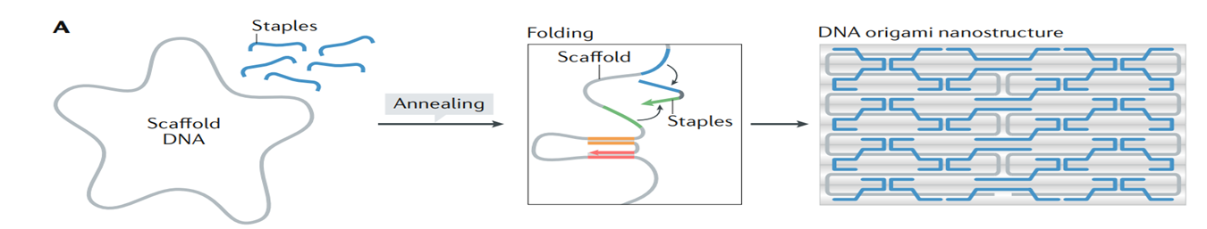

Slide 6
Applications of DNA Origami
Drug delivery: DNA origami structures can be used as nanocarriers to deliver drugs or other therapeutic molecules to specific target sites in the body.
Nanoelectronics: DNA origami can be used to create nano-sized electronic circuits and devices for applications in computing and data storage.
Sensors: DNA origami structures can be functionalized with sensors or probes to detect specific molecules or ions, making them useful for diagnostic or environmental monitoring applications.
Nanomaterials: DNA origami can be used as templates to create new materials with tailored properties, such as nanocomposites or nanoparticle arrays.

Slide 7
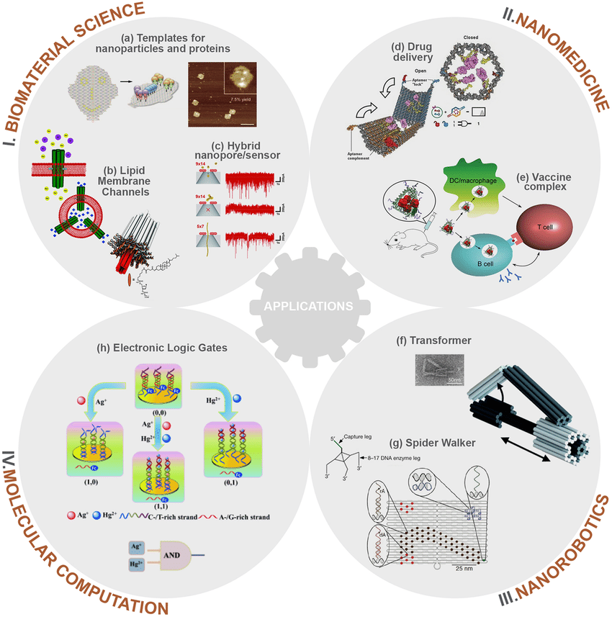

Slide 8
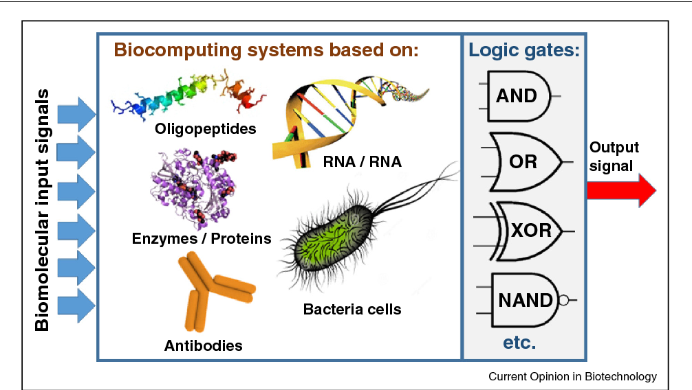
Biocomputing
Biocomputers are computers made of proteins, genes, and cells, and capable of performing mathematical operations, IF/THEN tests, and Boolean logic gate operations.
In general, biocomputing seek to use cells or biomolecules like DNA or RNA to perform functions, traditionally performed by electronic computer

Slide 9
Objectives of Biocomputing
The main goal of biocomputing is to mimic biological hardware of bodies, which includes
1. Using DNA or RNA as a medium of information storage and data processing
2. Connecting neurons to one another, similar to how they are connected in our brains
3. Designing computational hardware from the genome level up
Cells Already Compute
Cells are far more powerful at computing than our best computers. For example:
1. Cells store data in DNA
2. Receive chemical inputs in RNA (data input)
3. Perform complex logic operations using ribosomes ( ribosomes are structure in all cells helps in protein synthesis)
4. Produce outputs by synthesizing proteins

Slide 10
Bioimaging
Bioimaging refers to the use of imaging techniques to visualize biological structures and processes at various levels of resolution, from molecular to cellular to whole organism.
Bioimaging plays a crucial role in advancing our understanding of biology, medicine, and healthcare by providing non-invasive or minimally invasive ways to visualize and study complex biological systems.
Many detiled internal structures can be visualized and analysed
Techniques such as microscopy, magnetic resonance imaging (MRI), computed tomography (CT), ultrasound, and molecular imaging are commonly used in bioimaging.

Slide 11
Bioimaging Techniques
Microscopy: Enables visualization of cellular and subcellular structures using light microscopy, electron microscopy, or fluorescence microscopy.
Magnetic Resonance Imaging (MRI): Uses magnetic fields and radio waves to generate detailed images of internal organs, tissues, and structures in the body.
Computed Tomography (CT): Utilizes X-rays to create cross-sectional images of body tissues and organs, providing detailed anatomical information.
Ultrasound: Uses high-frequency sound waves to produce images of internal structures in real-time, commonly used for imaging organs, blood vessels, and developing fetuses.
Molecular Imaging: Combines imaging techniques with targeted contrast agents to visualize specific molecular or cellular processes, such as positron emission tomography (PET), single-photon emission computed tomography (SPECT), and optical imaging.

Slide 12
Applications of Bioimaging
Diagnostic Imaging: Bioimaging is widely used in clinical settings for the diagnosis and monitoring of various diseases and conditions, including cancer, cardiovascular diseases, neurological disorders, and musculoskeletal conditions.
Research and Development: Bioimaging plays a crucial role in advancing biological and medical research by providing insights into cellular and molecular processes, studying disease mechanisms, and developing new therapeutic strategies.
Drug Discovery and Development: Bioimaging techniques are used in preclinical and clinical drug development to assess drug efficacy, safety, and pharmacokinetics, and to monitor drug delivery and distribution in vivo.
Image-Guided Surgery: Bioimaging assists surgeons in planning and performing minimally invasive procedures, guiding surgical interventions, and improving patient outcomes.
Personalized Medicine: Bioimaging helps in tailoring medical interventions to individual patients by providing personalized diagnostic and treatment information based on their specific anatomical, physiological, and molecular characteristics.

Slide 13
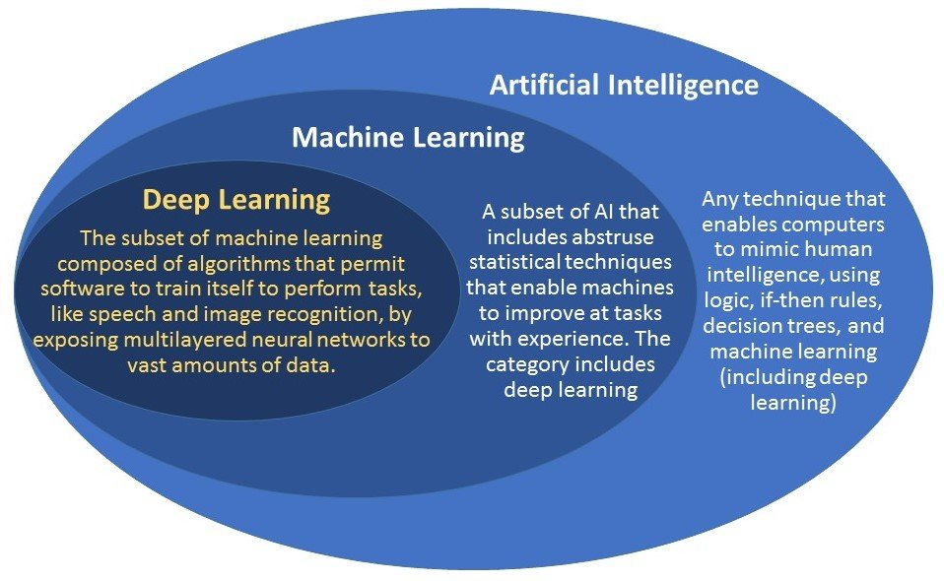
AI for disease diagnosis

Slide 14
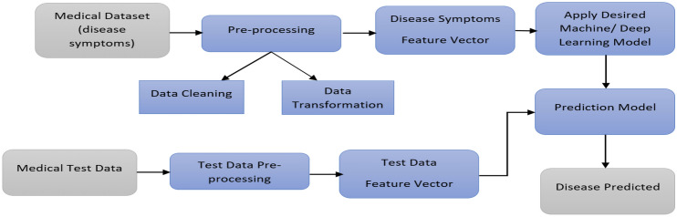
Workflow

Slide 15
AI in diagnosis of Heart Disease
AI can be utilized with substantial data evidence to support the accurate analysis of Ecodardigram (ECG) , various Arrythmias, ( Irregular heart beat) Echocardiography, , coronary artery disease (CAD) etc.
Various algorithms have been exploited in analysis and to support model prediction in cardiovascular medical field such as ANN,CNN, Naïve bayes, DT(Discission tree) etc.
AI in diagnosis of Cancer
AI is capable of diagnosing cancer with high accuracy. It can accurately determine grades for diagnosing prostate cancer
The deep learning algorithm performed better than the radiologist in detecting lung cancer on chest X-rays. For lung cancer, several deep learning AI models have been developed to help doctors find lung cancer on CT scans
Similarly AI models have been developed for detecting colon cancer
AI algorithms can assist doctors through analyses of routine health records, medical images, biopsy samples and blood tests to improve risk stratification and early diagnosis

Slide 16
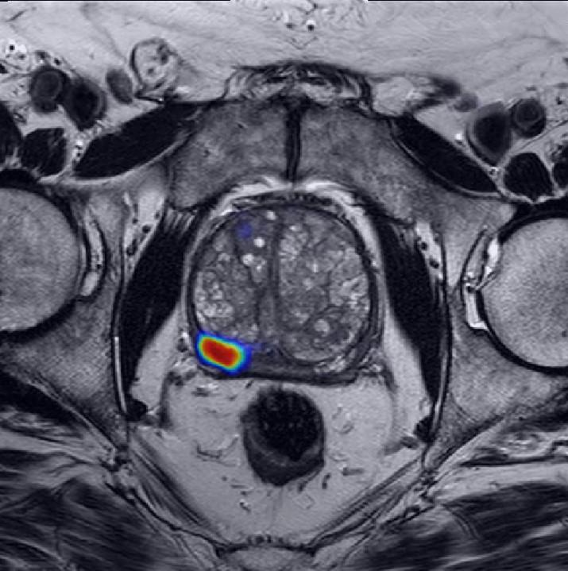
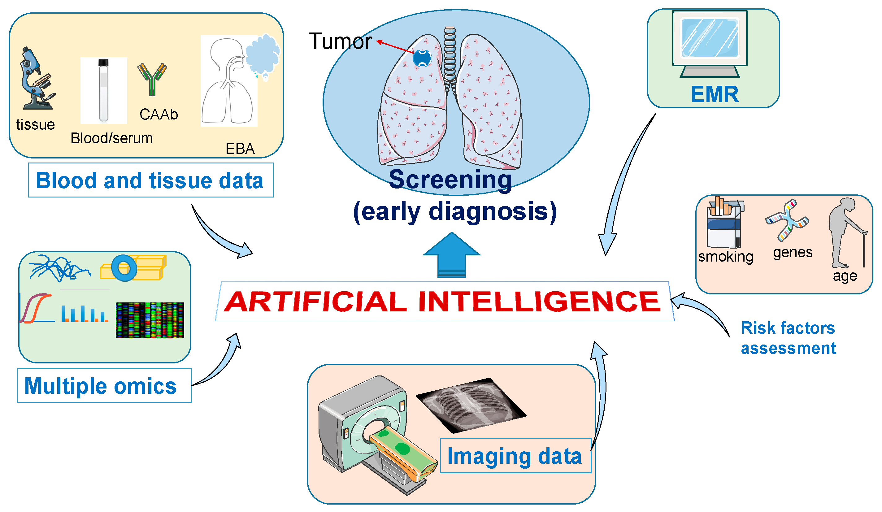
MRI scan of a patient's prostate,
a cancer-suspicious area (red)
is highlighted by an AI model
developed

Slide 17
AI in disease diagnosis
Machine Learning – particularly Deep Learning algorithms – have recently made huge advances in automatically diagnosing diseases, making diagnostics cheaper and more accessible.
Following are examples of other diseases diagnosis by AI
Assessing the risk of sudden cardiac death or other heart diseases based on electrocardiograms and cardiac MRI images
Accurate analysis of irregular heart beat, prediction of heart attack etc
Classifying skin lesions in skin images
Finding indicators of diabetic retinopathy in eye images
Predicting death risks

Slide 18
Major AI algorithms used in medicine for Disease diagnosis
1. Algorithms of Supervised Machine Learning : . Support vector machines ( SVM) , Random forests (RF) , . K-nearest neighbores., Naive Bayes classifier
2. Algorithms of Unsupervised Machine Learning : Clustering analysis, Principle component analysis ( PAC)
3. Deep Learning algorithms : Convolutional neural network, . Recurrent neural network , Generative Adversarial Networks (GANs)

